Slide 1


AMAZON SECURITY

Slide 2
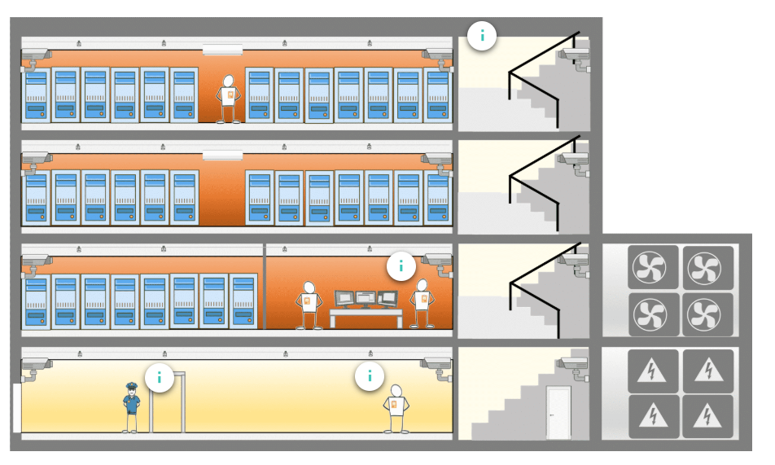

Permeter layers

Slide 3
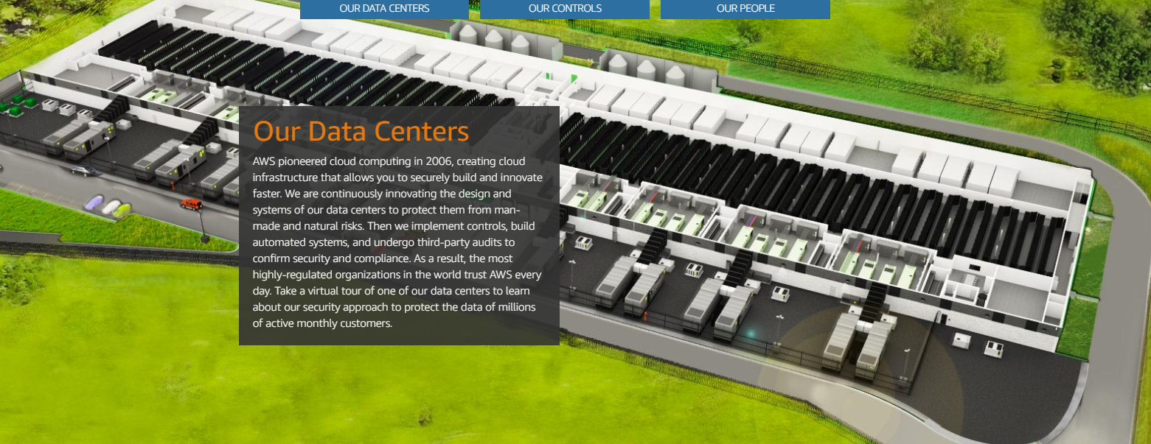
Permeter layers
https://aws.amazon.com/compliance/data-center/data-layer/

Slide 4
Security concepts
Compliance on AWS
AWS communicates about its security and control environment to customers by:
Obtaining industry certifications and independent third-party attestations.
Publishing information about AWS security and control practices in whitepapers and website content.
Providing certificates, reports, and other documentation directly to AWS customers under an NDA (as required).
Providing security features and enablers, including compliance playbook and mapping documents for compliance programs.

Slide 5
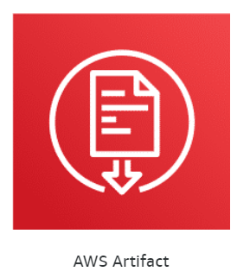
Security concepts
https://aws.amazon.com/artifact/

Slide 6
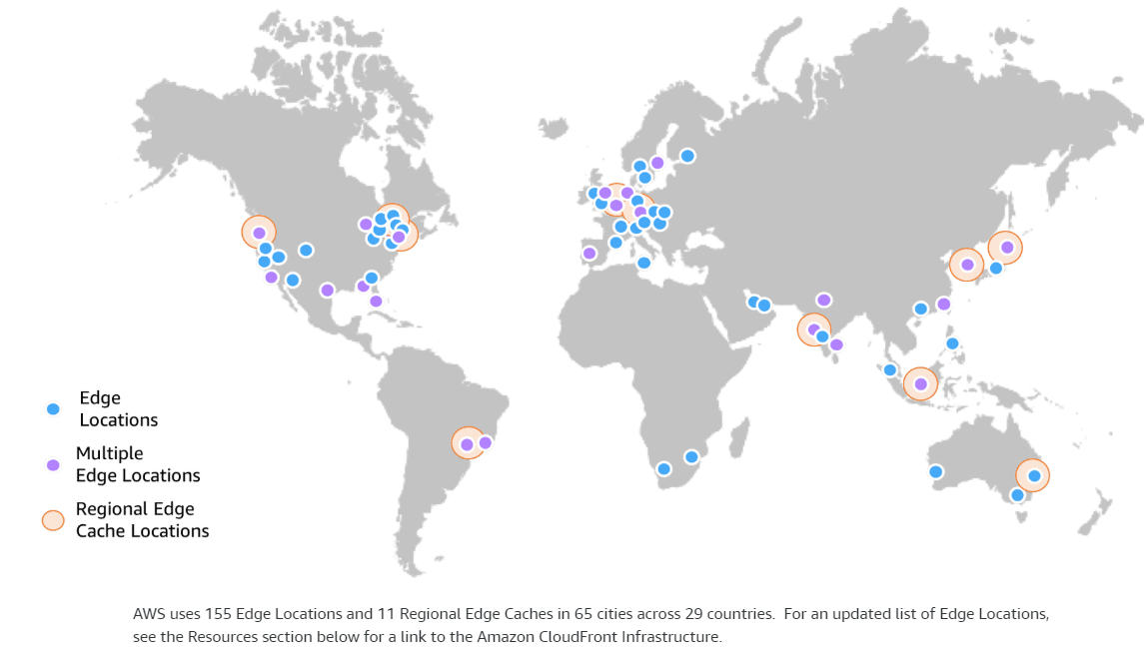
DDOS MITIGATION

Slide 7




Permeter layers
Route 53
Cloud Front
Shield
WEb Application
Firewall

Slide 8
Regional product services
https://aws.amazon.com/about-aws/global-infrastructure/regional-product-services/

Slide 9
AWS SERVICE ENDPOINTS
https://docs.aws.amazon.com/general/latest/gr/rande.html#ct_region

Slide 10
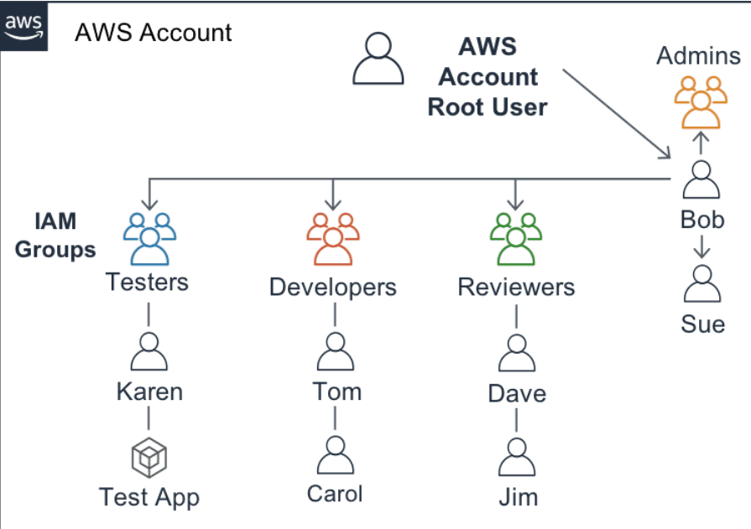
IAM PERMISSIONS

Slide 11
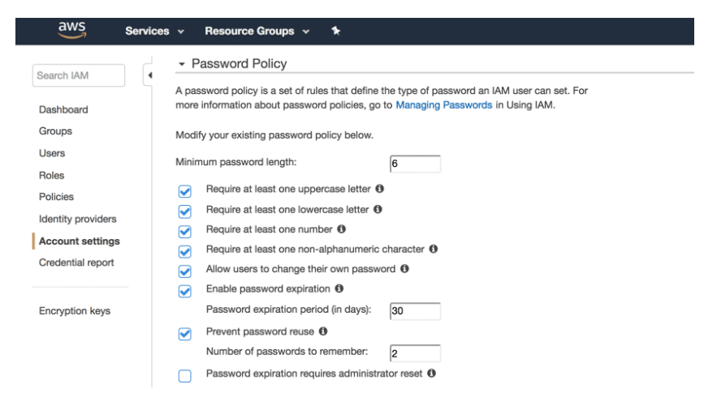
Username and password

Slide 12
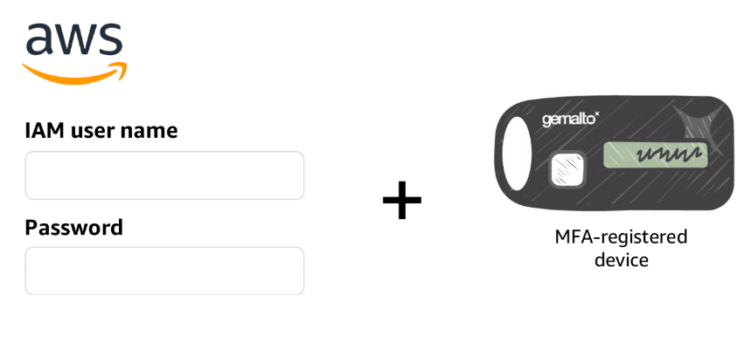
Multi factor authorization

Slide 13
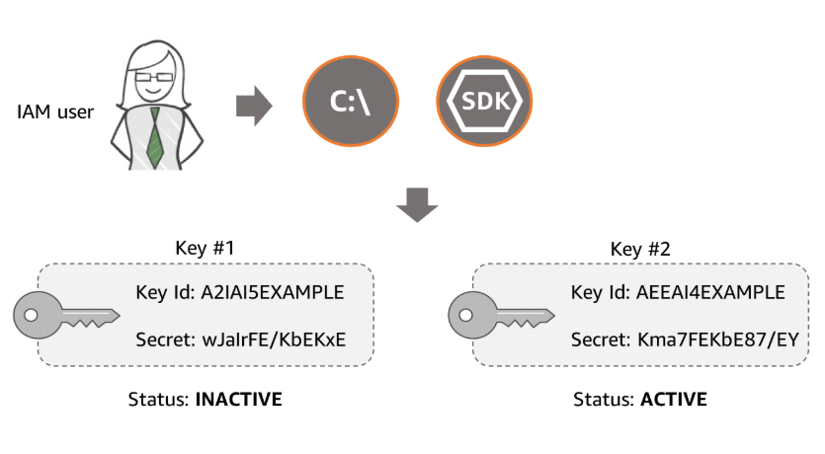
User access keys

Slide 14
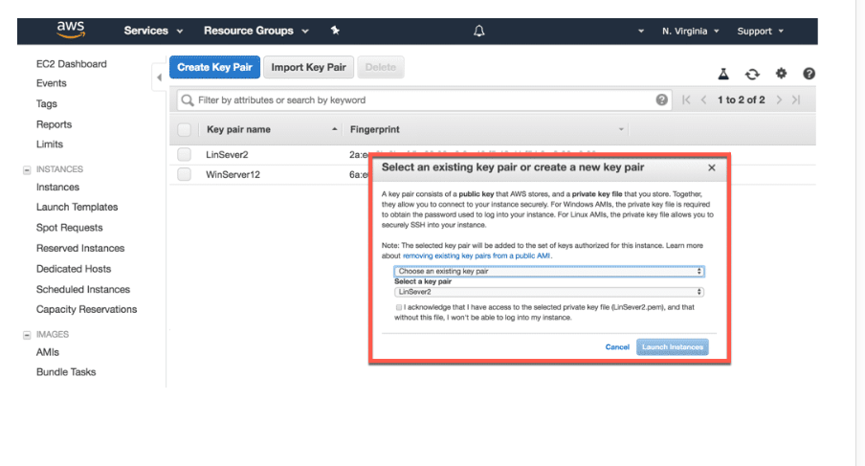
Ec2 key pairs

Slide 15




Other security stuff
Secrets
Manager
Simple
Token
Service
Directory
Service
Organization

Slide 16
Other security stuff
Secrets
Manager
Simple
Token
Service
Directory
Service
Organization

Slide 17
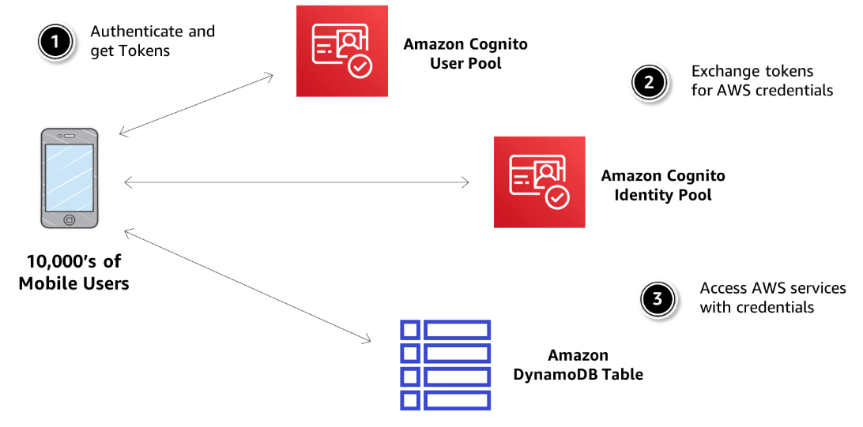

cognito

Slide 18
Permeter layers

